Slide 1

Global Academy of Technology Department of Computer Science and Engineering
Technical Seminar (15CSS86)
Brain Computer Interface for smart living environment
Name : Yogeshwarayya.S.hiremath
USN : 1GA15CS180
Guide : Mr. KRISHNA PRASAD R
Assistant Professor
Dept. of CSE, GAT

Slide 2
Index
Objective
Abstract
Introduction
Technologies Used
Implementation
Conclusion & Future Scope
Bibliography / References

Slide 3
Objectives
Brain-computer interface (BCI) provides a pathway communication between human brain and computer system.
Its main goal is to allow for non-muscular communication with external world, which may be the only way for patients in a locked-in state.

Slide 4
Abstract
Healthy brain signals are recorded using Electroencephalogram (EEG) and explored in order to be able to control some smart home appliances and a robotic arm for self feeder to help disabled persons, who cannot move or talk, to live independently in a brain-controlled environment.

Slide 5
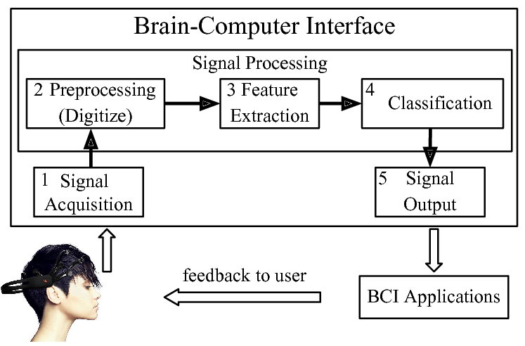
Introduction
A brain computer interface sometimes called a neural control interface, mind machine interface or brain machine interface is a direct communication pathway between an enhanced or wired brain and an external device.

Slide 6
Technologies Used
Steady state Visually evoked potentials
In neurology and neuroscience research, steady state visually evoked potentials (SSVEP) are signals that are natural responses to visual stimulation at specific frequencies.
The technique is used widely with electroencephalographic research regarding vision and attention.

Slide 7
Technologies Used
Electroencephalogram
An Electroencephalogram (EEG) is a test used to find problems related to electrical activity of the brain.
An EEG tracks and records brain wave patterns. Small metal discs with thin wires (electrodes) are placed on the scalp, and then send signals to a computer to record the results

Slide 8
Technologies Used
MATLAB
MATLAB (matrix laboratory) is a multi-paradigm numerical computing environment and proprietary programming language developed by Math Works.

Slide 9
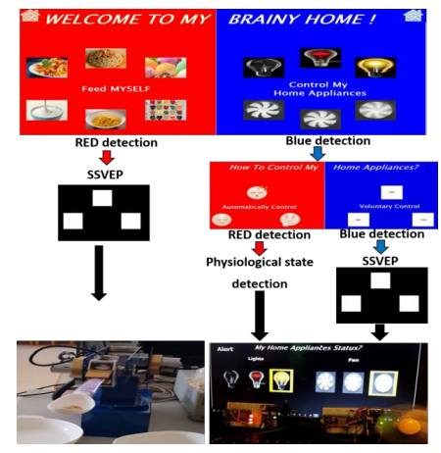
Implementation

Slide 10
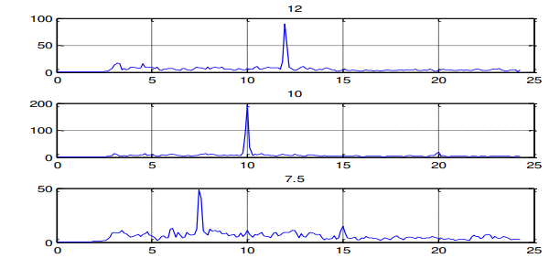
Implementation
The power spectral density of the trials corresponding to each of the three frequency are collected

Slide 11
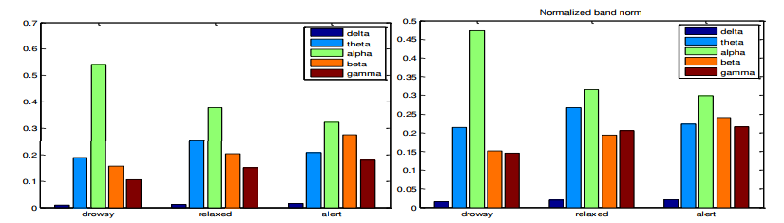
Implementation
The power spectrums for the three states at each channel, differences in the delta, theta, alpha, beta and gamma are noticed and thus their relative energy are computed.

Slide 12
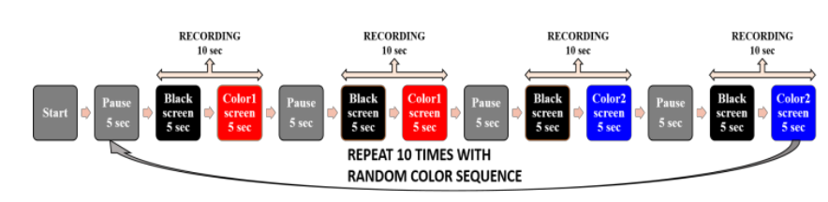
Implementation
Color Detection

Slide 13
Conclusion
Three powerful methods were projected into robotics and smart home domains. After acquiring the data offline and performing the training, many algorithms were implemented for processing and compared to choose the optimal ones.
The user uses his own built classifier to choose between two options by a red and blue color detection that does not require any effort.

Slide 14
Future Scope
BCI technology may be used for thought-to-text translation or to control movements of a prosthetic limb.
BCIs have potential to revolutionize the life of many people with motor disabilities, mobility issues, the way people communicate with the world, interact with information technology and the world itself.

Slide 15
Bibliography
[1] J.Wolpaw, N.Birbaumer, D.McFarland, G.Pfurtscheller and T.Vaughan, "Brain–computer interfaces for communication and control", in Clinical Neurophysiology, 2017, pp. 767-791.
[2] C. Holzner, C. Guger, C. Grönegress, G. Edlinger and M. Slater, "Using a P300 Brain Computer Interface for Smart Home Control", in World Congress on Medical Physics and Biomedical Engineering, Munich, Germany, 2018, pp. 174-177.
[3] Y.Wang, R.Wang, X.Gao, B.Hong and S.Gao, "A practical VEP-based brain-computer interface." in IEEE Transactions on Neural Systems and Rehabilitation Engineering ,2017, pp. 234-240.
[4] C. Holzner, C. Guger, C. Grönegress, G. Edlinger and M. Slater, "Control of a smart home with a brain-computer interface", 2019.
[5] K. Goel, R. Vohra, A. Kamath and V. Baths, "Home automation using SSVEP & eye-blink detection based brain-computer interface", in Systems, Man and Cybernetics (SMC), IEEE International Conference, 2018,

